Slide 1
Status Report (S04)
Team 9: Daniel Park, Brenden Pace, Alexander Lundin, Jairo Galarza
SE 4381.501
04/06/2018

Slide 2
Status
The status of this project is nearing completion. All that remains is to finish up the final presentation. All other aspects have been completed.
We had a lot of issues this week as we were creating the report. Mostly to do with the references. The references that we found were not helpful in summarizing our topic. Not enough information (1b) in the risk management was defined as a high concern during last weeks report. We did try to compensate by grabbing a few more resources, but we missed a major risk, having the right information.
This effect can be seen in the actuals column for the WBS.
1.4.1 took 0 hours to create as the sections were already defined for us.
1.4.2 took 4 hours to complete as not finding the right information took a while
1.5.1 took a lot of time because as a group we had to come to a realization what we had done wrong, and create a plan to solve the issue.
Notes:
-> then transfer to next slide where we talk about it.

Slide 3
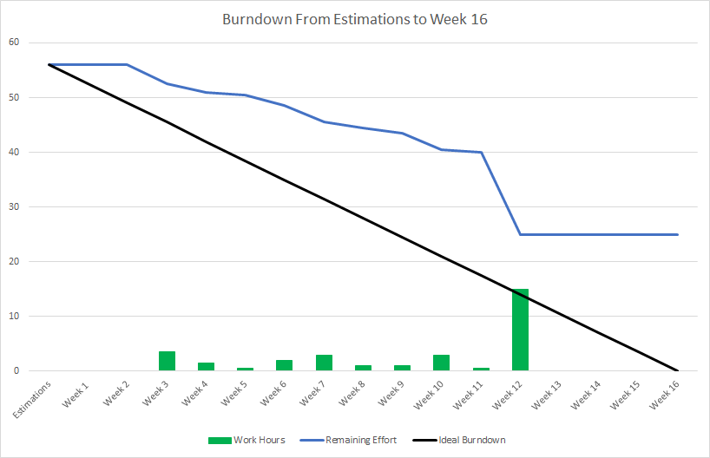
Burndown Chart
Notes:
-> then transfer to next slide where we talk about it.

Slide 4
WBS compared Burndown Chart
Level 1 | Level 2 | Level 3 Work Packages | Level 4 Estimations | Actuals
1 Overview of ISO/IEC/IEEE 12207 | 1.4 Document Observations | 1.4.1 Split Research into Subtopics | 3 hours | 0*
 |  | 1.4.2 Categorize Information and Quotes into the Split Subtopics | 2 hours | 4*
 | 1.5 Write Report | 1.5.1 Group Meeting and Create Report Outline based on Research | 2 hours | 4*
 |  | 1.5.2 Create a first Draft of the report based on Research | 4 hours | 3*
 |  | 1.5.3 Revise Report Draft and Report Outline | 2 hours | 1*
 |  | 1.5.4 Finalize report | 3 hours | 1*
Notes:
-> then transfer to next slide where we talk about it.

Slide 5
EV, PV, AC
Cumulative | Week 1 (2.26) | Week 2 (3.4) | Week 3 (3.11) | Week 4 (3.18) | Week 5 (3.25) | Week 6 (4.1)
PV | 3 | 8 | 13 | 21 | 33 | 45
AC | 3.5 | 5.5 | 6.5 | 10.5 | 14.5 | 31
EV | 8 | 8 | 13 | 15 | 23 | 44
What this tells us is that we are overestimating the cost of the different objectives. This should not be a surprise as we were clueless on many of the tasks. We also caught up a little on the AC compared to the EV. This was because of the huge hit on the references. This was discussed on the status section

Slide 6
Risk Status
Risks
Information
Conflicting source information. (Low)
Not enough source information. (High)
Wrong information gathered (High)
Personel
Presenter becomes ill on presenting day.
Team member becomes unable to work
Possible lack of transparency
Workload
Work packages that take longer than estimated.
Status
Information
Reviewing sources as a group before confirmation
Collected more sources and summarized them.
Had extra group meeting time dedicated to resolving the issues
Personel
Pass the ball presentation style, anyone will be able to step in
We have planned to cover for each other and are familiar with all the information that each team member has gathered
Created Team Rules document and that we all signed
Workload
Some work packages took less time to complete than expected, offsetting the packages that took longer than estimated to complete.

Slide 7
Traditional vs. Agile
Work breakdown structures are more detailed compared to product backlogs, such as providing an estimate on the number of hours required to complete each package. Product backlogs provide more abstract details in comparison.
One of the reasons why there is no equivalent of a activity network in an agile method is that activity methods are fairly inflexible, while agile methods are all about being flexible. Activity nodes must be completed before moving onto the next one.
The burndown chart gives a much clearer visual on the status of objectives, and gets across the information immediately compared to an EVM chart.
The approach our team prefers is the agile methods. The traditional methods, even though they provided more of a structure for our team, were more inflexible to work with in comparison to agile methods. There were frequent times where we could not work on the project because another part was left unfinished.

